Slide 1

Sociology and the Biopsychosocial Model
Module PT7001
Lubna Syed

Slide 2

Objectives
Introduction to sociology
Define Key Sociological Concepts
Explain the Biopsychosocial Model
Social Factors in Health
Integrate Sociology with the Biopsychosocial Approach
The Holistic Perspective

Slide 3

What is Sociology?
Sociology
Is the scientific study of human behavior and social structures.
examines patterns of social relationships and how they shape human behavior.
studies social structures and institutions, such as religion, education, government, and the economy.
helps us to understand the ways in which culture, socialization, and social structures impact our lives.

Slide 4
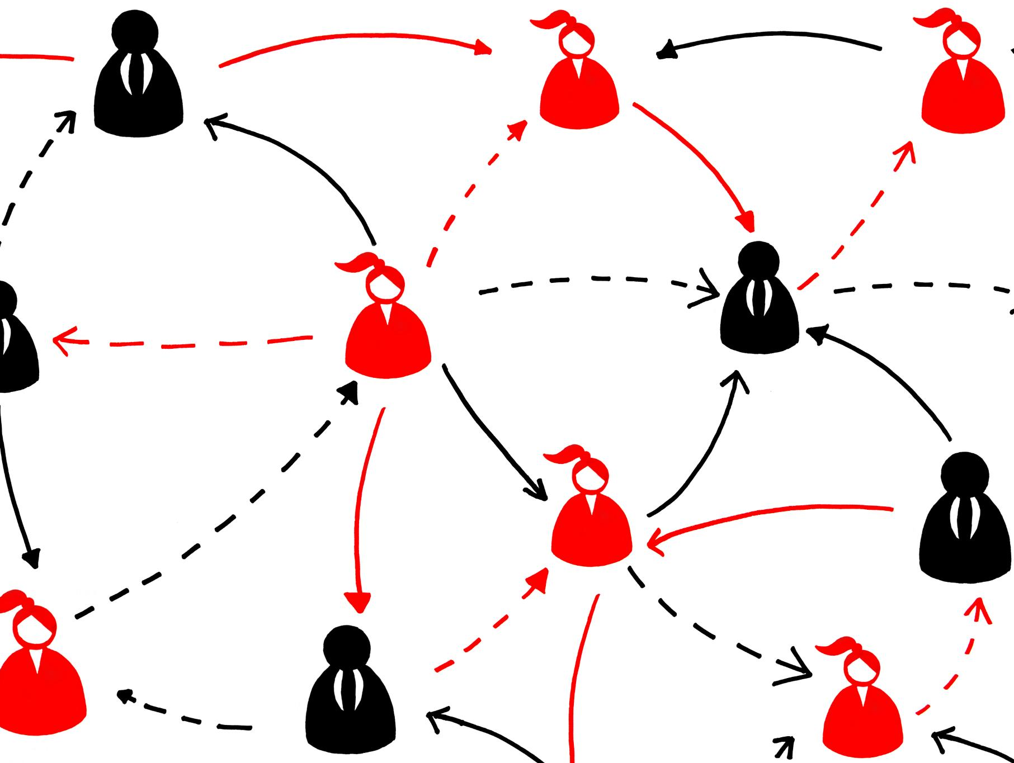
Sociology An Overview
Social Structures
  The organized patterns of relationships and social institutions that shape our lives, such as families, schools, and the workplace.
  Institutions
  Established and organized patterns of behaviour that govern social life. They include religion, education, government, and the economy.
Culture
  Refers to the shared beliefs, values, customs, behaviours, and artifacts that characterize a society or group. It includes language, art, music, and religion, among other things.
Socialization
  Process by which individuals learn the norms, values, and beliefs of their culture. It includes the ways in which we learn to think, feel, and behave as members of society.

Slide 5
Sociological Concepts

Slide 6

Understanding Social Structure
Social Hierarchies
  Social structure includes social hierarchies, such as class, race, and gender, which shape our opportunities and experiences in society.
Patterns of Relationships
  Social structure includes the patterns of relationships and institutions in society, which affect how we interact and communicate with one another.

Slide 7

Examining Culture and Norms
Culture and Identity
  Culture and norms shape our beliefs and behaviours, defining our identity and guiding our interactions with others.
  Social Norms
  Social norms are unwritten rules and customs that guide accepted behaviours and interactions in a society.

Slide 8

Roles and Institutions in Society
Family
  A fundamental institution in society that provides emotional support and helps shape our values and beliefs. It plays a key role in the development of children and in shaping their experiences and opportunities.
Education
  An important institution in society that plays a key role in shaping our experiences and opportunities. It provides knowledge and skills that are essential for personal and professional development.
Healthcare
  An essential institution in society that provides medical care and support to individuals and communities. It plays a key role in promoting health and well-being and preventing illnesses.

Slide 9

Understanding Socialization
ifelong process of learning and internalizing the norms, values, and beliefs of a society.
Important because it helps individuals to develop their sense of self and their place in society.
Types of socialization include primary, secondary, anticipatory, and resocialization.
Agents of socialization include family, peers, school, the media, and religion.

Slide 10

Brief History of Sociology
Auguste Comte
  Auguste Comte is regarded as the father of sociology. He developed the concept of positivism, which is a scientific approach to understanding society and social behavior.
Emile Durkheim
  Emile Durkheim is considered as one of the founding fathers of sociology. He created the first sociology department in France and his work on social solidarity and suicide is still widely studied today.
Max Weber
  Max Weber is widely considered as one of the most important figures in the development of sociology. He is known for his work on bureaucracy, social stratification, and the relationship between religion and capitalism.

Slide 11

Key Sociological Theories
Functionalism
  A sociological theory that views society as a complex system of interdependent parts that work together to maintain social order and stability.
Conflict Theory
  A sociological perspective that views society as a struggle for power between different groups, with resources and wealth being unequally distributed.
Symbolic Interactionism
  A sociological perspective that focuses on the ways in which people create and maintain social meaning through language, gestures, and symbols.

Slide 12
Biopsychosocial Model

Slide 13
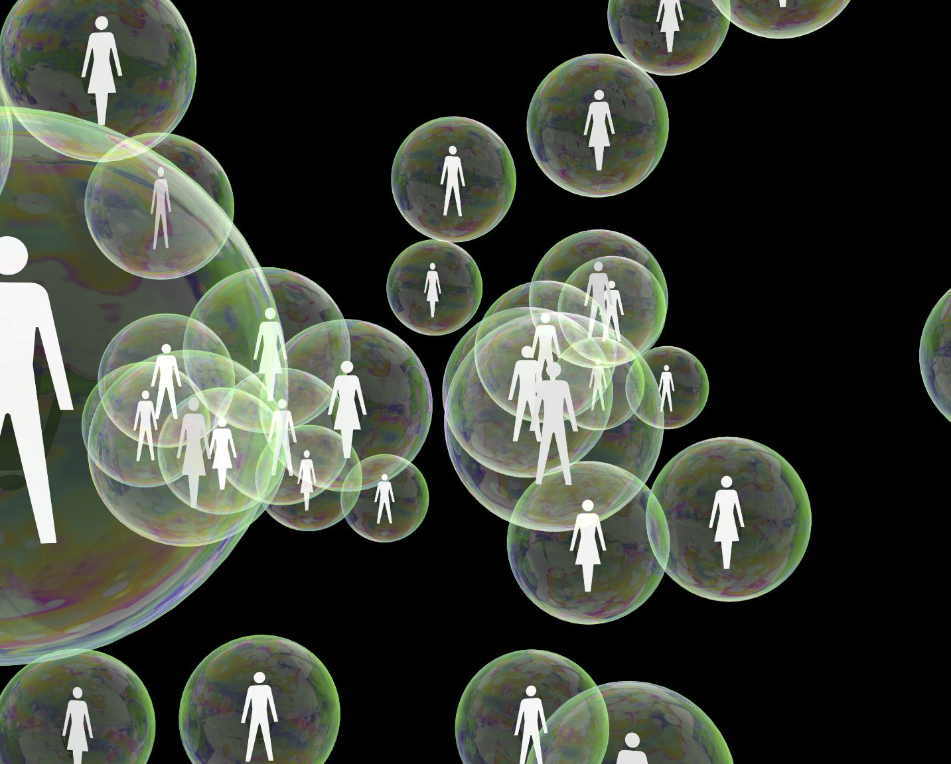
Overview of the Biopsychosocial Model
Definition of Biopsychosocial Model
  The biopsychosocial model recognizes that health and illness are shaped by biological, psychological, and social factors.
Whole Person Approach
  The biopsychosocial model considers the whole person

Slide 14

Relevance to Health and Human Behavior
  The biopsychosocial model recognizes the complex interplay of factors that influence our well-being, including social determinants of health, psychological and biological factors.

Slide 15
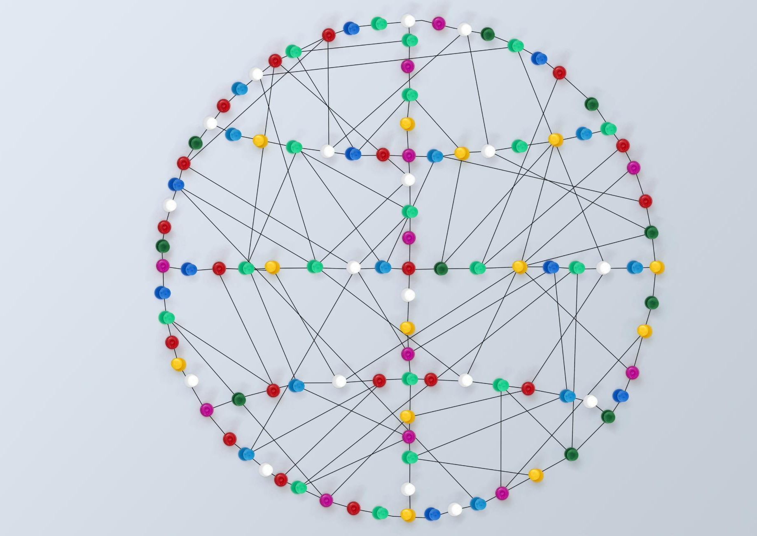
Interaction of Biological, Psychological, and Social Factors
  The biopsychosocial model recognizes the interaction of biological, psychological, and social factors in health and behaviour. This holistic approach considers the whole person and the complex interplay of factors that influence well-being.

Slide 16
Social Factors in Health

Slide 17

Impact of Socioeconomic Status and Culture
Socioeconomic Status Impact
  Socioeconomic status has a significant impact on health outcomes, with individuals from lower socioeconomic backgrounds experiencing poorer health outcomes compared to those from higher socioeconomic backgrounds.
Culture Impact
  Culture can influence beliefs about health and healthcare, affecting the way individuals seek healthcare and engage with healthcare providers.

Slide 18

Influence of Family Dynamics on Health Outcomes
Positive Family Relationships
  Positive family relationships and support can have a protective effect on health, improving overall physical and mental wellbeing.
Negative Family Dynamics
  Negative family dynamics, such as conflict, abuse, and neglect, can have a negative impact on health, increasing the risk of mental health issues, chronic diseases, and mortality.

Slide 19

Role of Social Support
Networks and Community
Social Support Networks
  Social support networks can provide important emotional and practical support, which can contribute to improved health outcomes.
Community Engagement
  Community engagement can promote social connectedness and well-being, leading to improved health outcomes.

Slide 20
Sociology And Biopsychosocial Approach

Slide 21

Synthesis of Sociological Concepts and the Biopsychosocial Model
Biopsychosocial Model
  The biopsychosocial model is a holistic approach to health that considers the interaction of biological, psychological, and social factors in shaping health outcomes.
Sociological Concepts
  Sociological concepts, such as social determinants of health and social support, can deepen our understanding of the social factors that influence health outcomes.

Slide 22

Strengths and Limitations of Both Approaches
Sociology Approach
  This approach has strengths in highlighting the importance of social determinants of health but also limitations in ignoring biological and psychological factors.
Biopsychosocial Model
  This approach has strengths in recognizing the complexity of health but also limitations in being difficult to operationalize and measure.

Slide 23
A Holistic Perspective

Slide 24
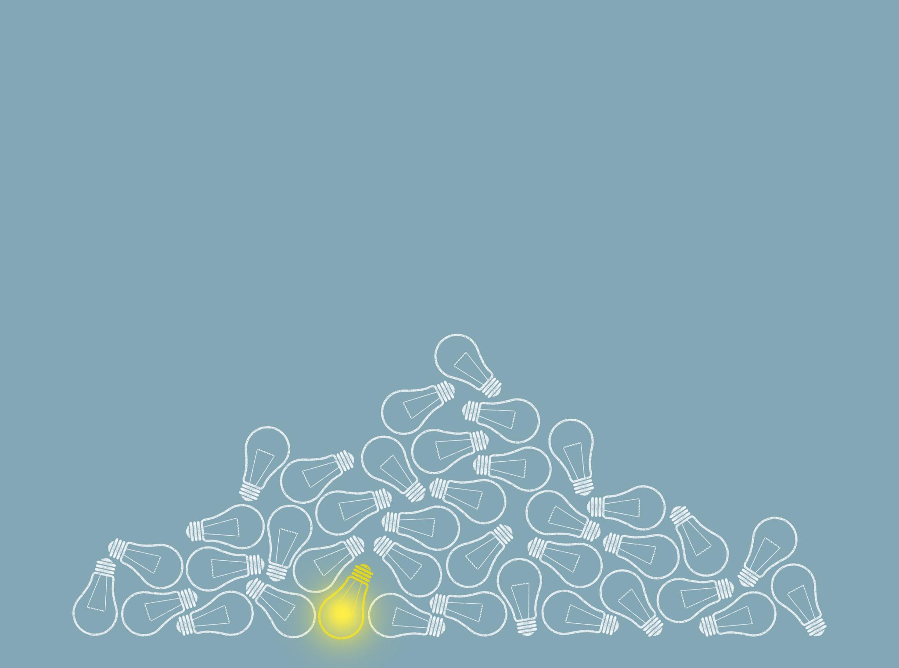
Importance of a Holistic Approach
Whole Person Approach
  A holistic approach considers the whole person, including their social, psychological, and biological context, to develop more effective interventions and promote better health outcomes.
Complex Interplay of Factors
  A holistic approach recognizes the complex interplay of factors that influence health and well-being, including social determinants of health, psychological factors, and biological factors.

Slide 25

Interdisciplinary Thinking in Healthcare and Social Sciences
  Interdisciplinary thinking is critical to a holistic approach to health, as it brings together different perspectives and expertise to gain a more comprehensive understanding of health and develop more effective interventions.

Slide 26
References
Gatchel, Robert J., Peng, Yuan Bo, Peters, Madelon, L.; Fuchs, Perry, N.; Turk, Dennis C. 2007 The biopsychosocial approach to chronic pain: Scientific advances and future directionsfckLR Psychological Bulletin, Vol 133(4), 581-624
Miaskowski C, Blyth F, Nicosia F, Haan M, Keefe F, Smith A, Ritchie C. A biopsychosocial model of chronic pain for older adults. Pain Med. 2020 Sep 1;21(9):1793-1805.
http://savvywillingandable.wordpress.com/2013/09/25/the-biopsychosocial-model-explained/
Wijma, A. J., van Wilgen, C. P., Meeus, M., & Nijs, J. 2016 Clinical biopsychosocial physiotherapy assessment of patients with chronic pain: The first step in pain neuroscience education. Physiotherapy theory and practice, 32(5), 368-384.
Nagasawa Y, Shibata A, Fukamachi H, Ishii K, Wicksell RK, Oka K. The Psychological Inflexibility in Pain Scale (PIPS): validity and reliability of the Japanese version for chronic low back pain and knee pain. J Pain Res. 2021 Feb 4;14:325-332.
Smith, Fortin, Dwamena, & Frankel. 2013. An evidence-based patient-centered method makes the biopsychosocial model scientific. Patient Education and Counseling, 91(3), 265-270.

Slide 27
Dictionary of the Social Sciences (2008) [2002]. Calhoun, Craig (ed.). "Sociology". New York: Oxford University Press – via American Sociological Association.
"Sociology: A 21st Century Major" Colgate University. American Sociological Association. Archived from the original on 18 October 2017. Retrieved 19 July 2017.
Ashley, David; Orenstein, David M. (2005). Sociological Theory: Classical Statements (6th ed.). Boston: Pearson Education.
Giddens, Anthony, Duneier, Mitchell, Applebaum, Richard. 2007. Introduction to Sociology. 6th ed. New York: W.W. Norton and Company. Chapter 1.
Yang, Jianghua (13 November 2023). "Beyond structural inequality: a socio-technical approach to the digital divide in the platform environment". Humanities and Social Sciences Communications. 10. doi:10.1057/s41599-023-02326- S2CID 265151025.
Macy, Michael W.; Willer, Robert (2002). "From Factors to Actors: Computational Sociology and Agent-Based Modeling". Annual Review of Sociology. 28: 143–166. doi:10.1146/annurev.soc.28.110601.141117. JSTOR 3069238.

